Slide 1

Quick Guide for Faculties & Students: Integrated Business Planning
SAP University Alliances
July 2022

Slide 2

Agenda:
What is the SAP IBP?
Why is it important?
Who is using SAP IBP? Customer List
How to get started? Your Learning Journey
Learning Objectives
Introduction assets
Case study
Exercises / Tutorials / Data sets (e.g. source code, model data sets)
Overview of learning resources

Slide 3

What is SAP IBP?

Slide 4
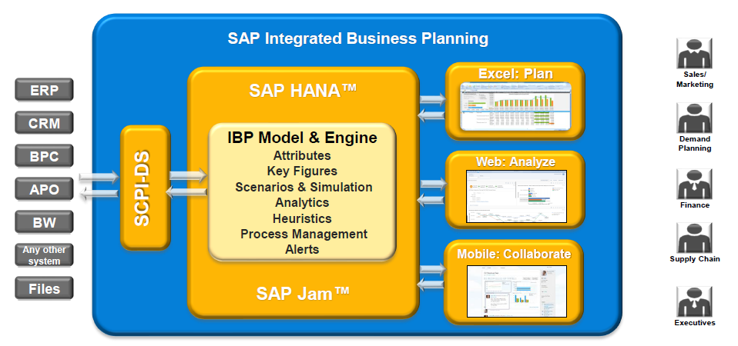
What is IBP?
SAP Integrated Business planning is a SAP state-of-the art platform that provides world-class supply chain planning capabilities to engage and connect stakeholders across one entire organization.
SAP IBP delivers a new paradigm of user experience and efficiency. SAP IBP is built on SAP HANA, for Cloud deployment.
IBP provides:
real-time dashboards and monitoring
Advanced predictive analytics
Interactive simulations
Embedded social collaboration
MS Excel-enabled planning tables
Integrated and unified planning across sales and operations, demand, inventory, supply and response planning
Notes:
Source: https://wiki.scn.sap.com/wiki/display/SCM/Getting+started%3A+SAP+Integrated+Business+Planning; https://archive.sap.com/documents/docs/DOC-61886

Slide 5
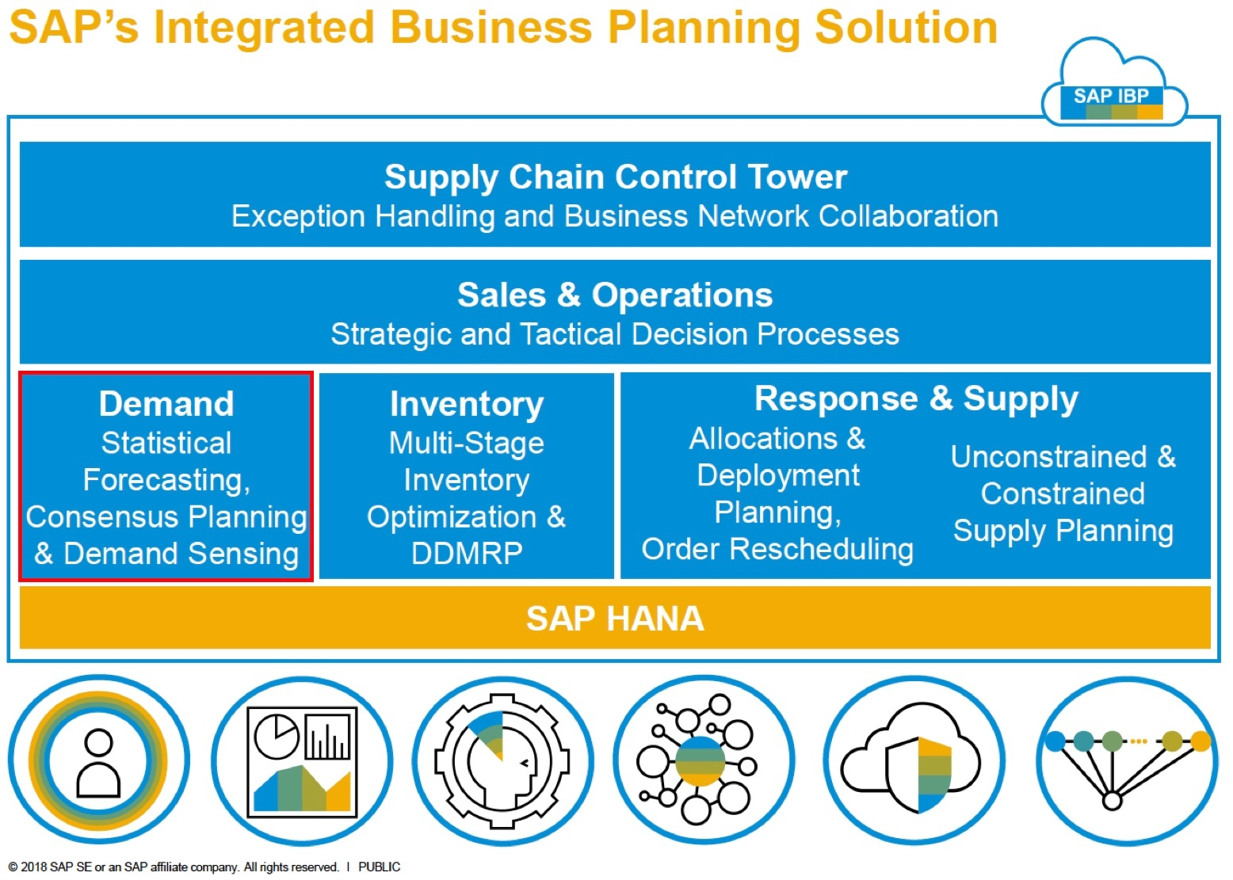
Application Modules of SAP Integrated Business Planning
SAP IBP features five modules:
SAP IBP for Sales and Operations
SAP IBP for Demand
SAP IBP for Inventory
SAP IBP for Response & Supply
Supply Chain Control Tower
All components can be applied independently or in combination. Video
Notes:
Source: https://community.sap.com/topics/integrated-business-planning
Show developed HW but after QA and presentation

Slide 6
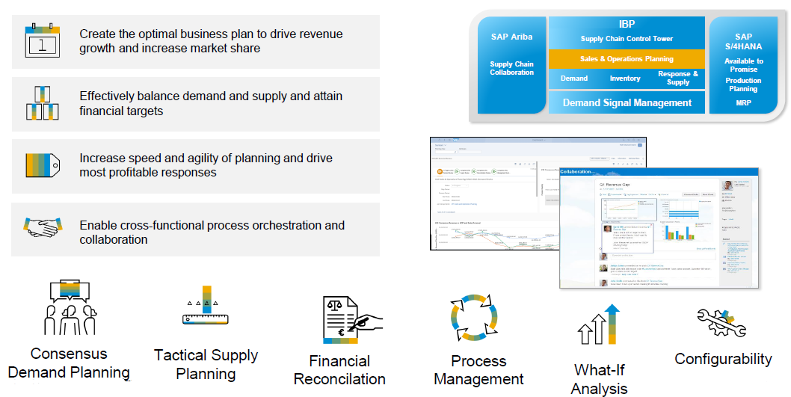
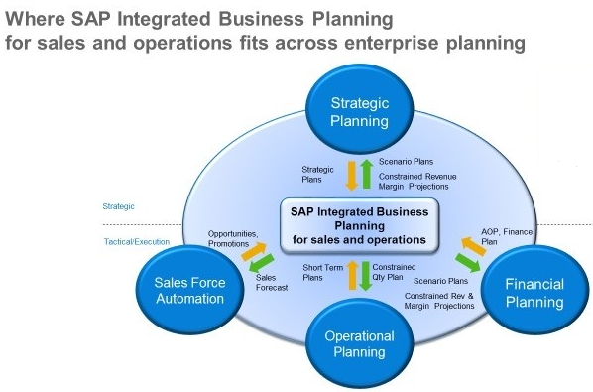
SAP IBP for Sales and Operations Planning
SAP Integrated Business Planning for S&OP delivers both Strategic and Tactical Execution. It includes Strategic, Financial, Operational Planning as well as Sales Force Automation so that it further aligns sales and operations plans to corporate strategy.
Notes:
Source: https://blogs.sap.com/2018/10/27/sap-integrated-business-planning-ibp-sales-and-operations-planning-2018/; https://wiki.scn.sap.com/wiki/display/SCM/SAP+Integrated+Business+Planning+for+Sales+and+Operations+Planning

Slide 7
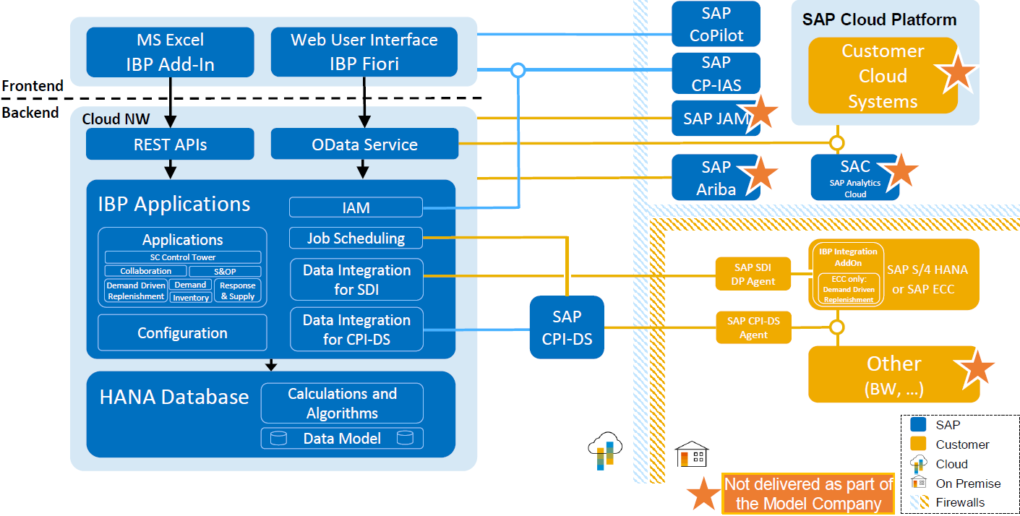
SAP IBP Architecture Overview System Landscape

Slide 8
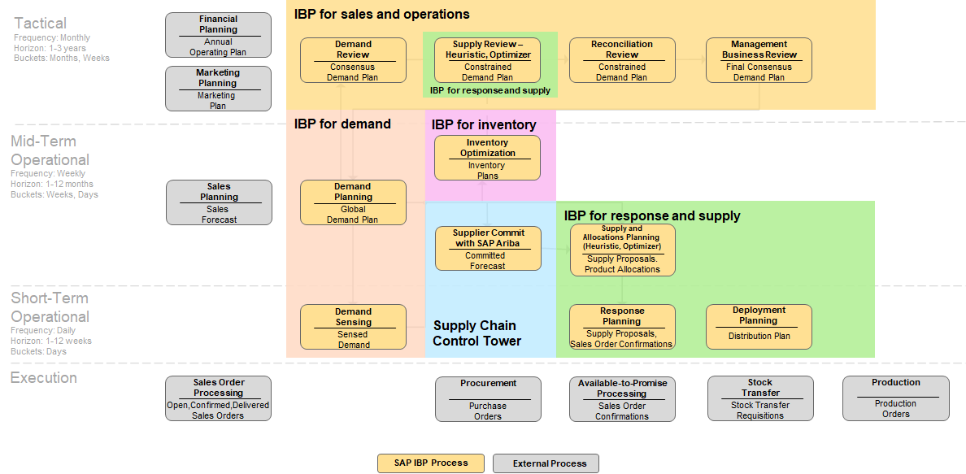
Unified planning process flow: Mapped to IBP applications
Notes:
In Prod we talk about three phases of planning…

Slide 9
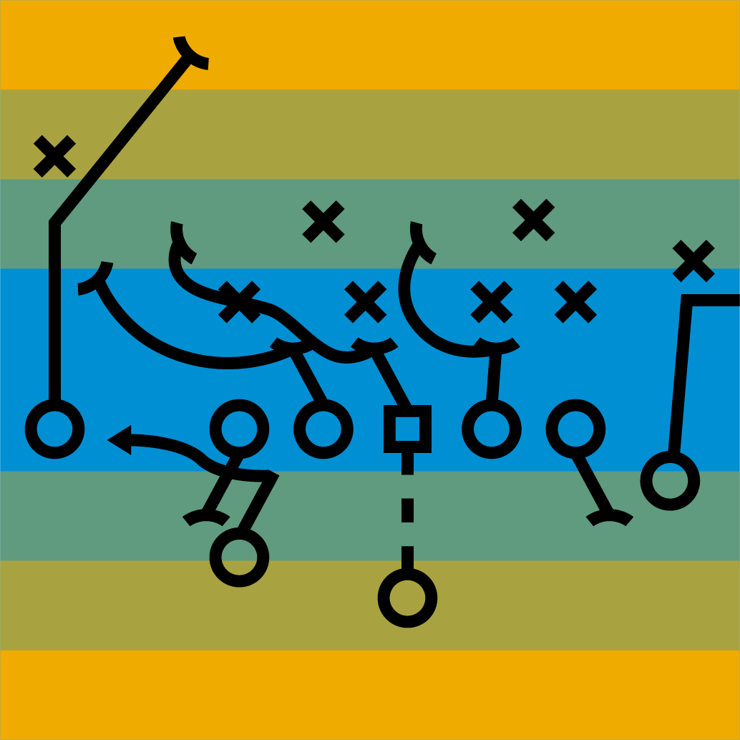
Why it is important? to manage supply chain with efficiency
63% of companies say that supply chain resiliency is a critical gap in their supply chain.
Visibility, agility, and resiliency play a critical role in an increasingly disruptive world.
Companies that invest in resiliency, supply chain transformation, and supply chain planning software will outperform those that do not.
source: IDC
Notes:
63% of companies say that supply chain resiliency is a critical gap in their supply chain.
Visibility, agility, and resiliency play a critical role in an increasingly disruptive world.
Companies that invest in resiliency, supply chain transformation, and supply chain planning software will out perform those that do not.
RESILIENT SUPPLY CHAIN PLANNING FOR A DISRUPTIVE WORLD, IDC#EUR146901920
https://www.sap.com/cmp/dg/synchronized-planning/index.html

Slide 10

Why SAP Integrated Business Planning?
To keep up with complex, fast-moving markets, you need world-class supply chain planning capabilities that engage and connect stakeholders across your organization. With the SAP Integrated Business Planning solution, you can:
Integrate sales and operations planning, demand planning and sensing, response and supply planning, and inventory optimization
Use social collaboration capabilities to rapidly refine forecasting and demand management
Get end-to-end supply chain visibility and run powerful predictive analytics on SAP HANA
Create what-if simulations to evaluate different plans and understand the potential impact of decisions
Notes:
SAP IBP is a cloud-solution based on SAP HANA technology. The figure shows the different modules within the SAP IBP Landscape and the processes they support. The individual functionalities come together to support the S&OP (Sales and Operations) processes. The top most layer is the visualization layer to get a high-level view of the health and status of the Supply Chain of an organization.
IBP Modules' Functionality
SAP IBP's Modules Cover the Core Supply Chain Planning Functionality in One Integrated Platform.

Slide 11
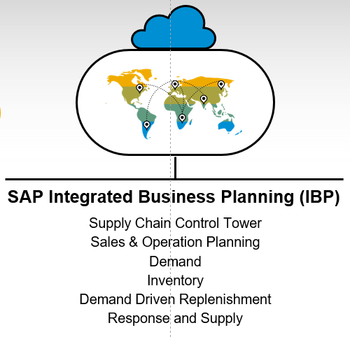
Why should students know about SAP Integrated Business Planning?
Since COVID-19 pandemic, more and more enterprises are realizing that having a strong, resilient Supply Chain are critically important to their business
Planning and Simulation is the most fundamental and core part that not only the data matters, but more importantly the ability to leverage it to generate different scenarios and make more agile decisions across the entire supply chain
SAP IBP enables businesses optimize their resource efficiency, and to make use of real time visibility to both supply and demand to perform scenario planning, and inventory optimization strategies
Learn more
Notes:
Basic MRP And advanced MRP classes

Slide 12
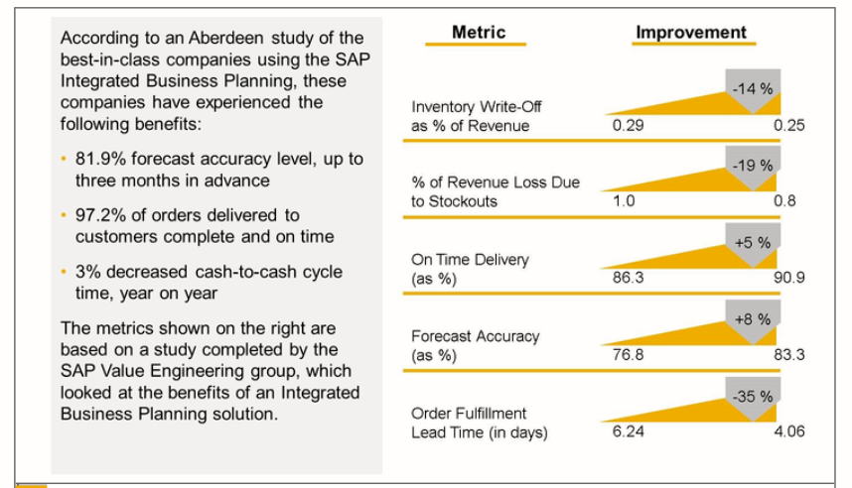
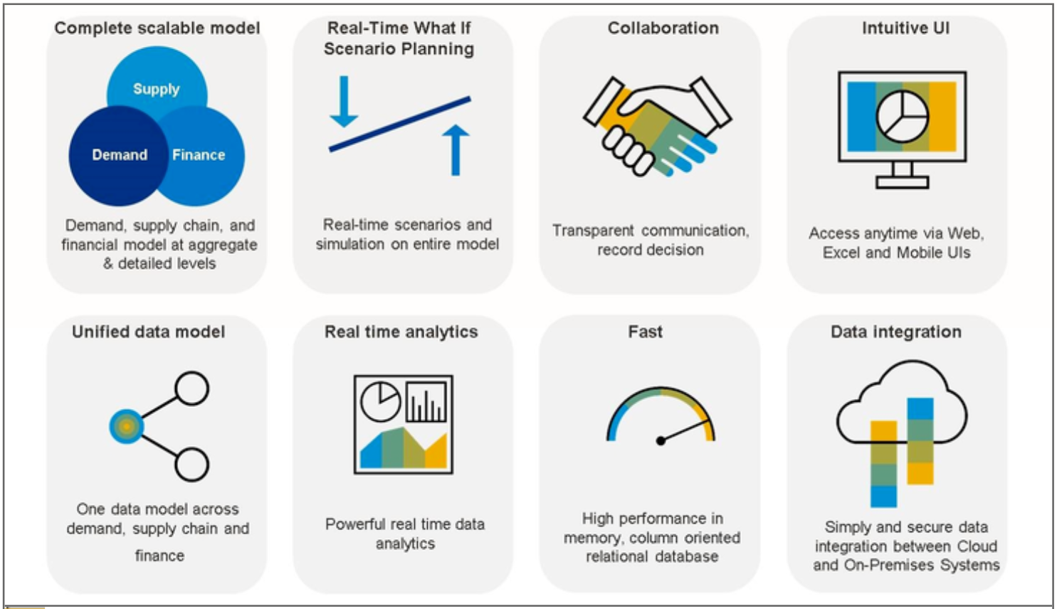
Benefits of learning SAP IBP
Gain practical knowledge of
Integrated Business Planning, which extending the principles of Sales & Operation Planning (S&OP) across the supply chain
Demand-Driven MRP which aims to solve the shortcomings of traditional MRP in the new normal
To understand and experience
world-leading in-memory computing enabled and cloud-based enterprise planning solution
powerful supply chain analytics, what-if simulation, alerts, and more that leveraging cutting-edge technologies such as AI, machine learning…

Slide 13

More SAP customer success stories & cases could be found following he links below
Microsoft
Monsanto
Corning
Grünenthal
Blue Diamond Growers
American Sugar Refining
Varex Imaging
Centrica Hive
Chassis Brakes
Lennox International
McCain Foods
Vestas
Notes:
Source: https://wiki.scn.sap.com/wiki/display/SCM/Getting+started%3A+SAP+Integrated+Business+Planning

Slide 14
SAP IBP Learning Journey

Slide 15
SAP Integrated Business Planning Didactic Concept
Learning Objectives
Introduction to Integrated Business Planning （IBP） Understand the overall IBP solution and the core planning processes and functionality in each of its five modules Learn the basic navigation and planning steps in the user interface
Learning Scenarios
Basic Concepts of SAP to Integrated Business Planning core planning processes and functionalities of each module with SAP to Integrated Business Planning
Learning Characteristics
System Functionalities, Model Company and Dataset
Global Bike dataset Best Run Bikes dataset Bicycle material master records(CSV files) Bicycle sales transaction records (CSV files)
Learner Type | Novice
Level / Academic Degree | Bachelor, Master
Learning Method | Case studies
Language | English, German

Slide 16
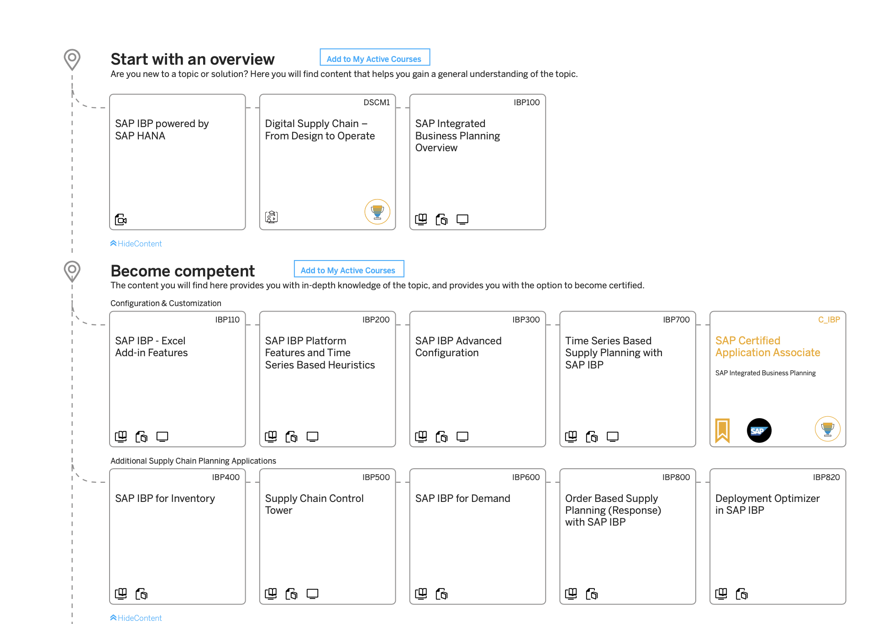


SAP Integrated Business Planning: Learning Journey Register to SAP Learning Hub Edition for SAP Next-Gen to get full access to Learning Journey Materials
Notes:
Link to Learning Journey: https://help.sap.com/doc/221f8f84afef43d29ad37ef2af0c4adf/HP_2.0/en-US/500384cd7a2610148ae5bfbc243fe983.html

Slide 17



SAP Integrated Business Planning Overview of Learning Resources
Customer Success Stories Upcoming Events and Webinars | https://www.sap.com/about/customer-stories.html?sort=latest_desc&tag=products:supply-chain-management/sap-integrated-business-planning-for-supply-chain/sap-integrated-business-planning-for-supply-chain https://wiki.scn.sap.com/wiki/display/SCM/Events+and+Webinars+for+SAP+Integrated+Business+Planning
Explore SAP IBP : Learning Journey | https://help.sap.com/doc/221f8f84afef43d29ad37ef2af0c4adf/HP_2.0/en-US/500384cd7a2610148ae5bfbc243fe983.html
SAP IBP: product page SAP IBP: Get Started SAP IBP : Learning Hub SAP IBP Training | https://www.sap.com/products/integrated-business-planning.html https://www.sap.com/products/integrated-business-planning/get-started.html https://programsearch-prod.cfapps.eu10.hana.ondemand.com/#/?query=IBP https://training.sap.com/trainingpath/Cloud-SAP+Integrated+Business+Planning-Supply+Chain+Planning
SAP Community: IBP | https://community.sap.com/topics/integrated-business-planning
SAP Community WiKi | https://wiki.scn.sap.com/wiki/display/SCM/Getting+started%3A+SAP+Integrated+Business+Planning

Slide 18
Topics for IBP Curriculum Development– 5 areas of IBP
Sales & Operations
Demand
Inventory
Response & Supply
Supply Chain Control Tower

Slide 19
Try IBP & Have Fun.
SAP University Alliances team
Email: sapnextgen@sap.com
Email: boza@usc.edu
Thank You

